Slide 1
Sign language Recognition
Umair Manzoor (2020-Cs-24)
Musawir Ahmad (2020-Cs-44)
Zain Hassan (2020-CS-134)

Slide 2
Outline
Introduction
Objectives
Problem Statement
American Sign Language (ASL)
Technology Stack
Related Work
Proposed Work
Methodology

Slide 3

Introduction
Communication, key for socialism.
Visual clues.
Sign language, an un-common language.
150+ gesture languages.

Slide 4

Objective
Understanding and sensitivity to the deaf and hard of hearing community are improved via study of signed language.
If you know signed language well, you'll have a deeper understanding of deaf culture and be able to encourage others to understand and respect the sign language.
The hope of lowering the communication gap between the deaf and hearing communities is what drives this initiative.

Slide 5
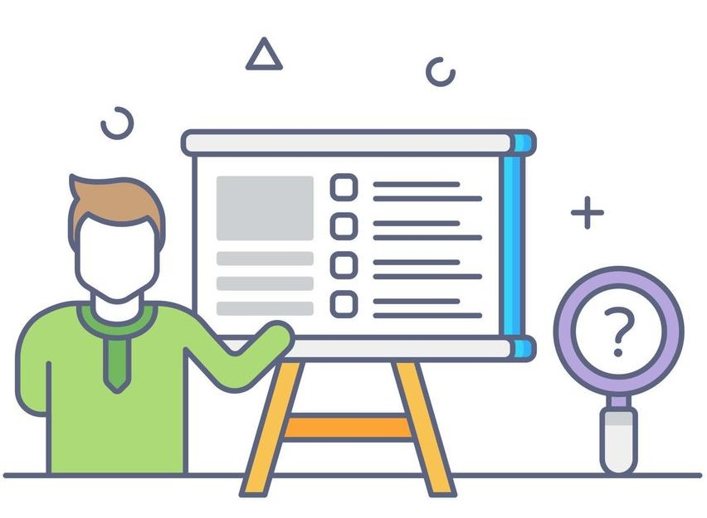
Problem Statement
Normal people have trouble understanding the hand signs used by deaf individuals because they use them to communicate.
Therefore, there is a need for systems that can identify various indications and communicate information to regular people.

Slide 6
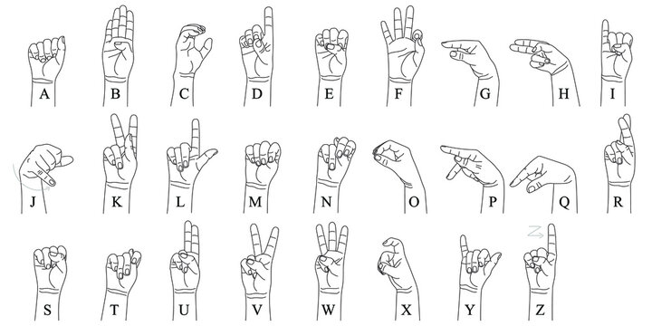
American Sign Language (ASL)

Slide 7



Technology Stack
Python
TensorFlow Object Detection API
OpenCV

Slide 8
Related Work
A glove-based gesture recognition system created by Christopher Lee and Yangsheng Xu was able to recognize 14 of the hand alphabetic letters, learn new gestures, and update the model of each gesture in the system in real-time.
A systematic literature search was performed by adopting the PRISMA guidelines. The articles were extracted in June 2021 from three academic databases namely Scopus, ProQuest and IeeeXplore.

Slide 9
Proposed Work
Using image processing, we are carrying out our project.
Our project's key benefit is that it is not limited to use with black backgrounds.
With any background, it can be used.
Additionally, our method does not mandate the wearing of color bands.

Slide 10
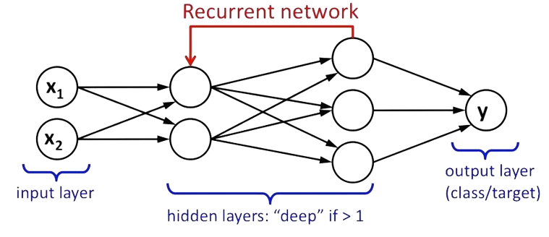
Methodology
Neural Network:

Slide 11
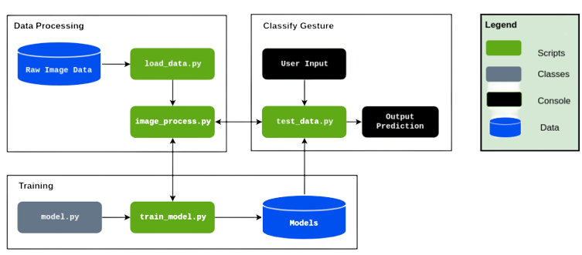
Methodology
Data Processing
Training
Classify Gestures

Slide 12
Limitations
Precise monitoring: hand gestures, hand occlusion, and high computing cost.
Dataset: sizable, general data sets that could be used to translate sign language to natural language.
Accuracy: translation system’s accuracy is extremely low and has to be raised.

Slide 13
